Slide 1
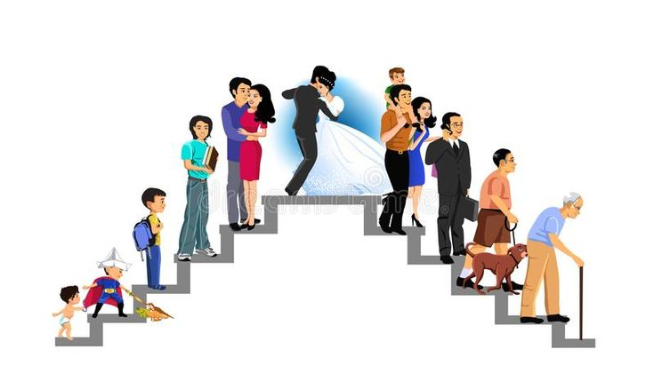

Slide 2
PLC PRODUCT LIFE-CYCLE

Slide 3
PLC- PRODUCT LIFE-CYCLE
Limited life
Different Stages- Challenges
Profits –Rise and fall
Different strategies at each stage
Bell shaped curve
PRODUCT LIFE-CYCLE management is the succession of strategies used by business management as a product goes through its life-cycle.
The conditions in which a product is sold changes over time and must be managed as it moves through its succession of stages.

Slide 4
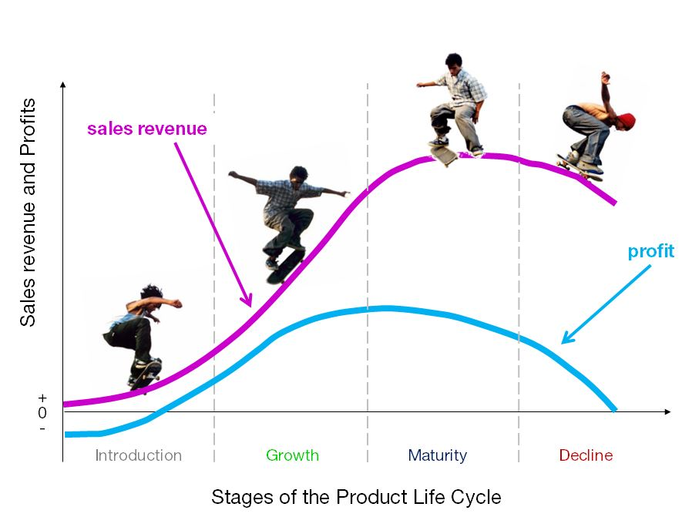
Time

Slide 5
PLC curve is typically divided into four stages ➤ Introduction: A period of slow sales growth as the product is introduced in the market. Proﬁts are non-existent in this stage because of the heavy expenses incurred with product introduction. ➤ Growth: A period of rapid market acceptance and substantial proﬁt improvement. ➤ Maturity: A period of a slowdown in sales growth because the product has achieved acceptance by most potential buyers. Proﬁts stabilize or decline because of increased competition. ➤ Decline: The period when sales show a downward drift and proﬁts erode.

Slide 6
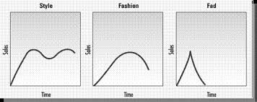
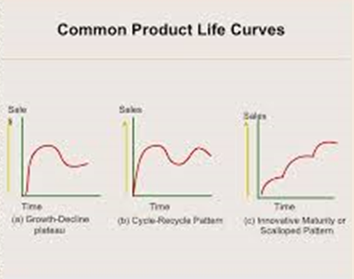
Style Fashion Fad
Growth Slump Maturity Pattern Cycle-Recycle pattern Scalloped Pattern

Slide 7
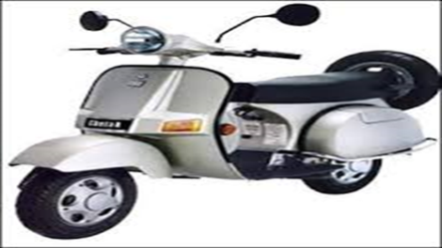

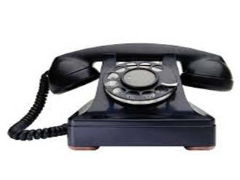


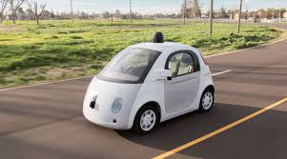







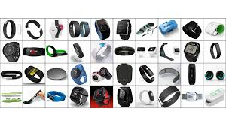
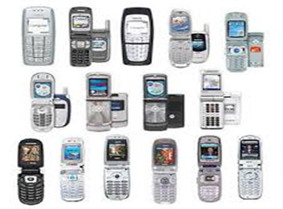
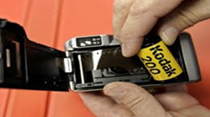






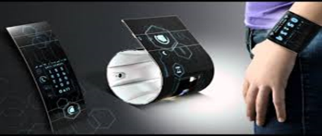

Slide 8
Introduction- 5G, Driverless cars, Sport Leagues, OTT Growth-LED, Plasma Tv, Wearables, Smart watches, Electric cars, Smartphones, Ecommerce, Ready to eat foods, Solar Maturity- FMCG, cola majors Decline- Feature Phones, Landline phones, CDs, DVDs

Slide 9
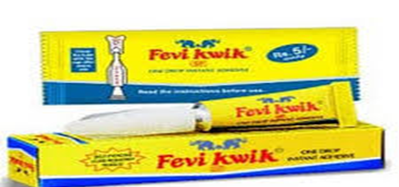
Increase users uses Occasions Frequency
'chutki mein chipkaye' Instant adhesive
Toy and chasma-can be used to fix a whole host of objects
Versatile, Professional Use, all purpose, reuse

Slide 10
Fevikwik Humour in marketing-Pidilite Industries. 'Toy and chashma'. -aimed at broadening the brand's appeal beyond its established position as a 'one-drop instant adhesive'. -Fevikwik's versatility. By increasing the usage occasions - moving from professional use to home use to being an all-purpose fixer - instant adhesives market with the proposition of 'chutki mein chipkaye' . Pidilite enjoys a leadership position (with over 60 per cent share) both in the Indian adhesives market as well as the instant adhesive category (80 per cent share). The new campaign aims to target young people by urging them to reuse and recycle products.

Slide 11

GSK Horlicks to Sensodyne
Shifting focus to power brands Sensodyne toothpaste and OTC drugs. This marks a shift for the first time in over three decades, away from its mainstay Horlicks in the country.
The Rs4,000-crore Horlicks which competes head-on with Mondelez’s Bournvita and Heinz’s Complan, leads the milk food drink category with near 70% share but headroom for growth is relatively less.
It is slowing down for good reason and there are more nutrition choices like breakfast cereals and so on,”
In India, the power brands will be Sensodyne, Panadol (called Crocin in India), nasal decongestant Otrivin and Voltaren pain relieving gels and rubs.

Slide 12
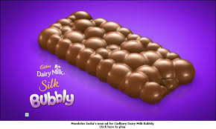
Mondelez - 'Bubbly'
Bubbly is an aerated chocolate - a puffed-up chocolate - which is a product innovation that requires special technology given the sticky nature of chocolate. In Bubbly's case, the air bubbles are both inside and outside of it, hence the name.
Fast moving consumer goods (FMCG) analysts say that by launching the country's first aerated chocolate, Mondelez is also attempting to bring much needed spark into its India business, which has been reeling under a discretionary slowdown in the last few quarters.

Slide 13
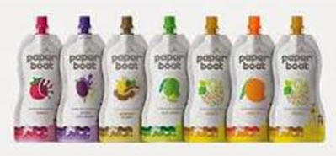
Paper Boat Hector Beverages -special drinks for special occasions
Nonaerated beverage brand has decided to do something disruptive.
launch of the
Thandai (an almond ­flavoured beverage) for North India timed around Holi.
Panakam (jaggery­based drink) - to coincide with Rama Navami festival for the Southern market.
Kacchi Lassi that would make an entry around Baisakhi .
Rose Sherbet during Ramzan.

Slide 14
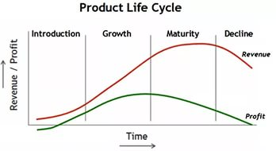
Characteristics
Characteristics | Introduction | Growth | Maturity | Decline
Sales | Sales Low | Rapidly rising sales | Peak sales | Declining sales
Costs | High cost per customer | Average cost per customer | Low cost per customer | Low cost per customer
Proﬁts | Negative | Rising | High | Declining proﬁts
Customers | Innovators/Early adopters | Early adopters/ Early Majority | Middle majority | Laggards
Competitors | Few | Growing number | Stable number beginning to decline | Declining number

Slide 15
Marketing Objectives & strategy
Objectives/ Strategies | I-Create product awareness and trial | G-Maximize market share | M- Maximize proﬁt while defending market share | D-Reduce expenditure and milk the brand
Product | Offer a basic product | Offer product extensions, service warranty | Diversify brands and items models | Phase out weak product
Price | Charge cost-plus | Price to penetrate market | Price to match or best competitors’ | Cut price
Place Distribution | Build selective distribution | Build intensive distribution | Build more intensive distribution | Go selective: phase out unproﬁtable outlets
Advertising | Build product awareness among early adopters dealers | Build awareness and interest in the mass market | Stress brand differences and beneﬁts | Reduce to level needed to retain hard-core loyals
Sales Promotion | Use heavy sales promotion to entice trial | Reduce to take advantage of heavy demand | Increase to encourage brand switching | Reduce to minimal level

Slide 16
Limitations
It is difficult for marketing management to gauge accurately where a product is on its life cycle. A rise in sales per se is not necessarily evidence of growth, a fall in sales per se does not typify decline.
Different products possess different PLC "shapes“
Typical PLC models are only useful as a rough guide for marketing management.
For specific products, the duration of each PLC stage is unpredictable and it's difficult to detect when maturity or decline has begun.
Because of these limitations, strict adherence to PLC can lead a company to misleading objectives and strategy prescriptions.

Slide 17
NPDP New Product Development Process

Slide 18
Innovation Idea Invention Discovery Innovation- It changes the life of the customer in some way, or the world in which the customer experiences things that’s an innovation. Invention-is the product of a creative and curious mind Discovery- Already there Ideas- by themselves change nothing

Slide 19
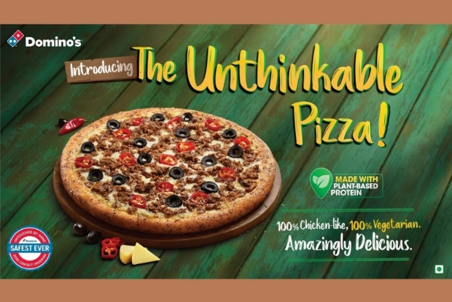
Jubilant FoodWorks,-Domino's Pizza franchise introduced "The Unthinkable Pizza", India's first plant protein based product.
The Unthinkable Pizza is made entirely from plant-based proteins, is 100% vegetarian and yet has the sensory properties of chicken.
Jubilant FoodWorks is India's largest food service company, with a network of
1,264 Domino's Pizza restaurants across 281 cities (Approx.).
The company has the exclusive rights to develop and operate Domino's Pizza brand in India, Sri Lanka, Bangladesh and Nepal.

Slide 20
NESTLE In-home indulgence segment of products and introduced new products under MAGGI- Cooking Made Simple service.
Sunbean Coffee
NETFLIX
Frapuccino-a thick milkshake with ice cream
51 variants- Activa

Slide 21
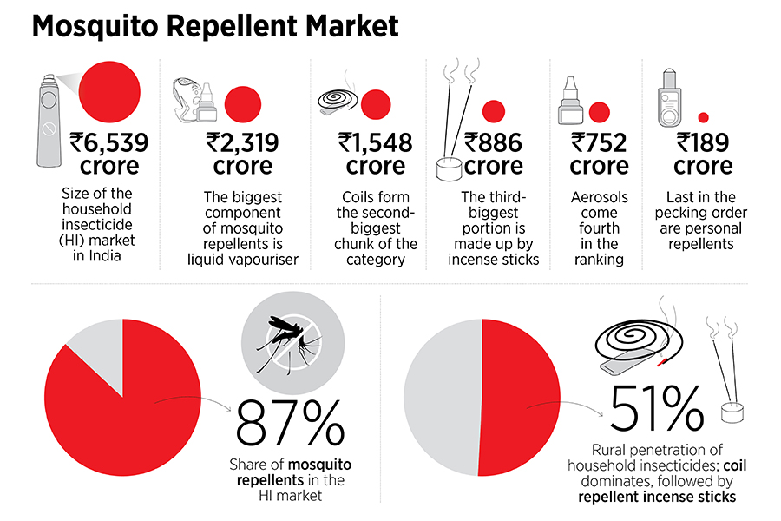

Slide 22
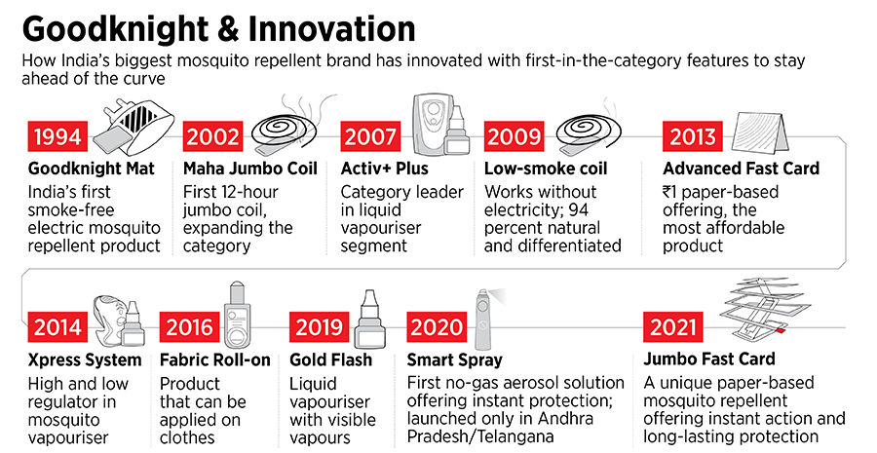

Slide 23
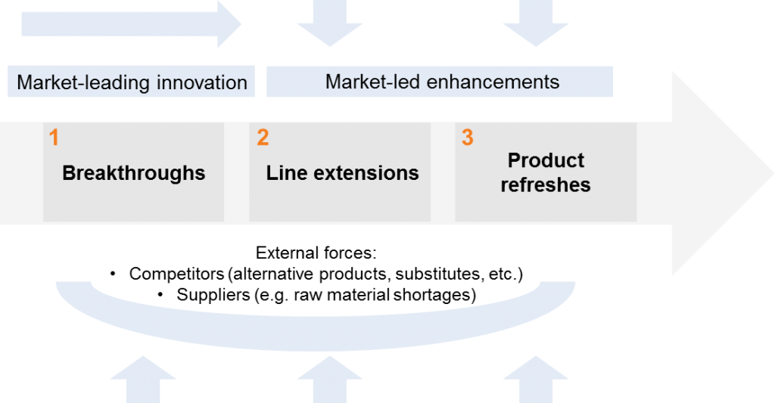
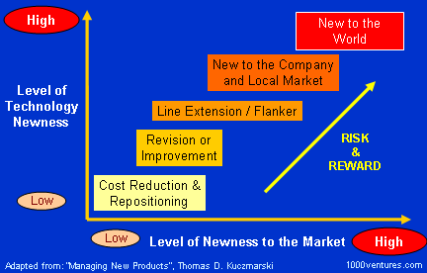
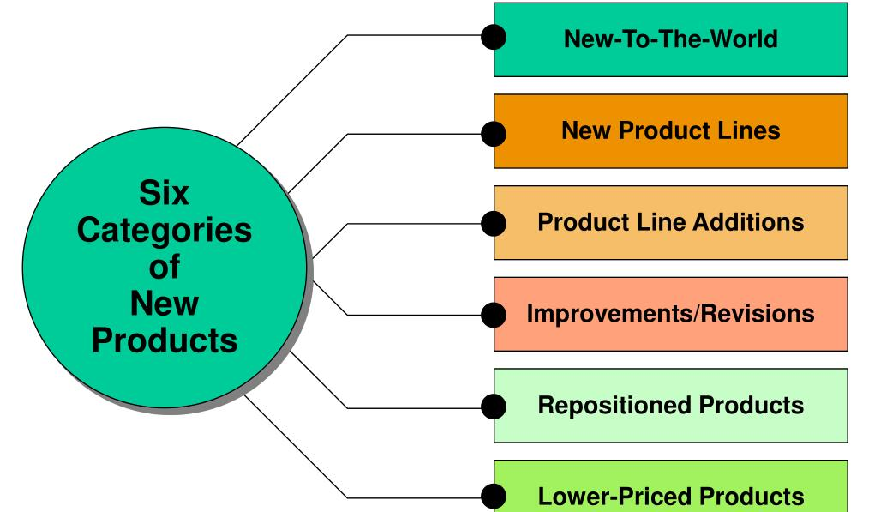
New to company products, meaning that the company have never developed or sold this product before, but other companies might have.
New to market products, and these are products that were never seen before in the marketplace.

Slide 24
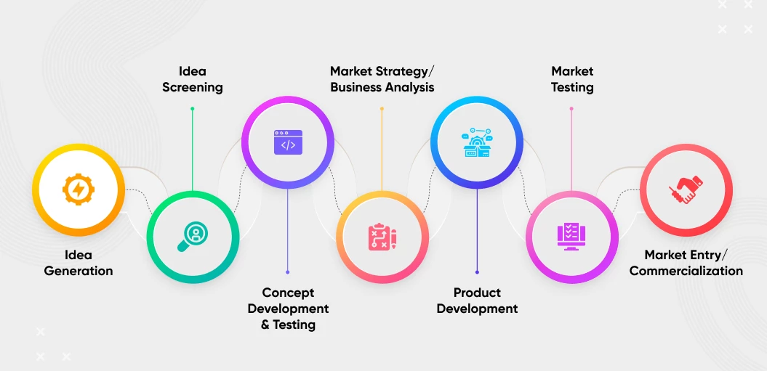
New Product Decision Process

Slide 25
Pampers
In 1956, when a P&G researcher experienced the inconvenience of frequently changing and washing his baby grand daughter’s diapers, he decided to try and develop a diaper that was absorbent, kept babies dry, and was disposable.
In 1961, after six years of intensive research, Pampers, was introduced in the US market.
Test marketing- Fabelle-ITC

Slide 26
What makes a good new product is a point of difference
A lot of companies are trying to say that what are the reasons that we have to give the consumer to believe the benefit. Particularly, with cosmetics, it makes your skin better or whatever, and the reason if you believe the benefits are the ingredients. If the reason is plausible, the benefit becomes credible.
Major companies like Procter, Unilever and Reckitt are investing a lot on R&D. It seems to be there is less innovation. May be there is a feeling that there is so much technological innovation as it is that a slightly better fabric detergent doesn't interest people very much.

Slide 27
The consumer adoption Process of Innovation

Slide 28
Contact Lenses
Electric Cars
Weight Loss
Hair Transplant
Hair Straighteners
Online Jewellery
Online Education

Slide 29
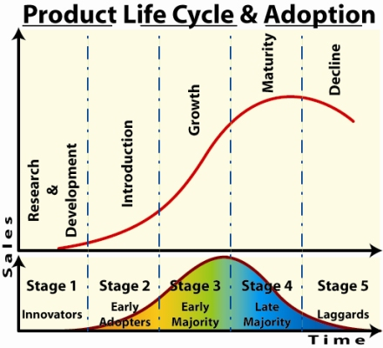

Slide 30
The consumer adoption Process of Innovation
The consumer adoption process is the mental steps through which an individual passes from first hearing about an innovation to final adoption.
Adopters of new products move through five stages
1 Awareness- Becomes aware, lacks information
2 Interest- Stimulated to seek information about innovation
3 Evaluation- Considers whether to try innovation
4 Trial – Tries it
5 Adoption – Decides regular use
The new product marketer should facilitate movement through these stages
Readiness to try new products: Persons level of innovativeness is the degree to which an individual is relatively earlier in adopting new ideas than the other members of his social system. In each product area there are pioneers and early adopters some people are the first to adopt new things. Some doctors are first to prescribe new medicines.

Slide 31
The five adopters group
1 Innovators- Are technology enthusiasts, Venturesome
2 Early Adopters- Are opinion leaders, who carefully search
3 Early Majority- Adopts when benefits are proven, Mainstream market
4 Late Majority- Are skeptical conservatives, who are risk averse, technology shy, and price sensitive
5 Laggards- are tradition bound and resist the innovation until they find that the status quo is no longer defensible.

Slide 32
Adoption –Innovation diffusion
Adoption is an individuals decision to become a regular user of a product.
Years ago, new product marketers used a mass- market approach to launch products, which had two main drawbacks, It called for heavy marketing expenditures and it wasted many resources.
New product marketers now aim at early adopters and use the theory of innovation diffusion and consumer adoption to identify them.
An innovation is any good, service or idea that someone perceives as new, Innovations takes time to spread.
Everett Rogers defines the innovation diffusion process as the “the spread of a new idea from its source of invention or creation to its ultimate users or adopters.

Slide 33
Thank you

